Slide 1
This planet is ours to lose

Slide 2
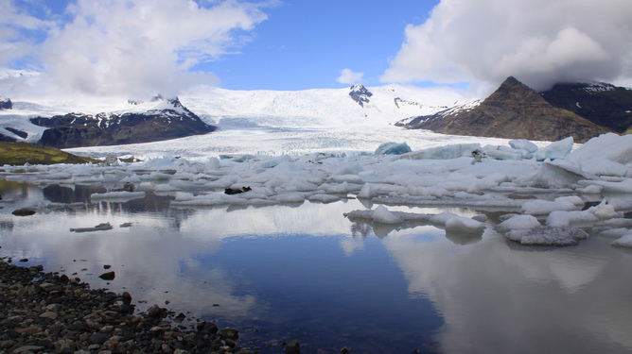
We are at a historical moment
Notes:
Juncture is better, but if you think it is too difficult, ‘moment’ might do?

Slide 3
and need to change

Slide 4
Carbon is not the way to fuel growth

Slide 5
Nor is piling up more debt for consumption

Slide 6
The investments
required - to change course,
are of epic proportions
Notes:
To rescue the planet and the economy we need to invest more than 10x over the next few decades. Its like making a small economy of Australia become China, over night. It is physically impossible and will never happen. If only for the fact that China has 56x more people (1400mio vs 25mio)

Slide 7
How to pay for them?

Slide 8
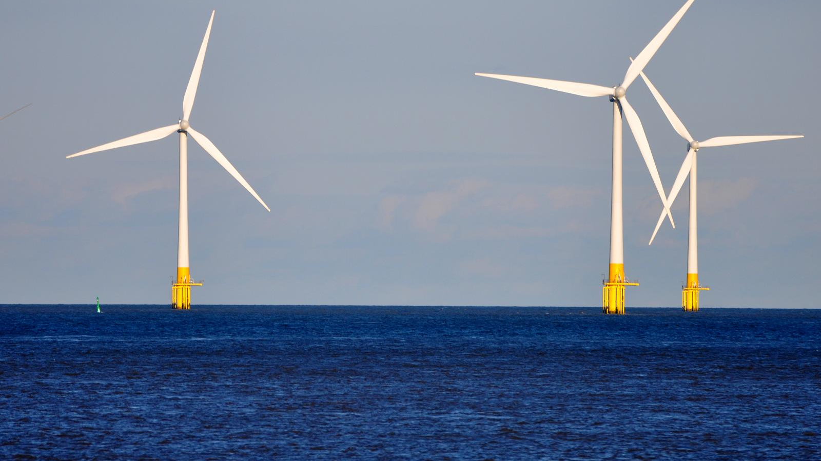
a more sustainable way….
We need
Det här fotot av Okänd författare licensieras enligt CC BY
Notes:
Today we are using taxes to pay for public investments and anything else the government is paying for. In other words taxpayers, like you and me are paying for everything the government is involved with.
Debt or borrowing money will have to be paid by taxes at some point in time. Why borrowing money, i.e. debt, is taxes to be paid by future generations like todays young people or the children.
Just as with our planet or our biosphere, we are intimately connected also in a an economic perspective. We need to find a balance between what we take from the biosphere and what we leave behind for our descendants. The same goes for our economy. There is a limit to how much tax a government can charge before there is a revolt from the people. Borrowing money seems to be pushing the problem to future generations and therefore nothing we care about today. As long as everyone can have fun and consume today, we are all happy. Until the young people realise we are robbing them of a future not only with climate but also of a healthy economy.

Slide 9
..to pay for
The green energy transition
Notes:
shift towards solar- and wind-generated electricity.
combined with batteries, hydrogen and other forms of storage,
as well as a role for bioenergy and carbon capture in the medium run

Slide 10
infrastructure able to protect us
from a changing climate
Notes:
Infrastructure networks will be affected by the physical impacts of climate change, and will play an essential role in protecting us against to those impacts. Extreme events illustrate the extent of this potential exposure.
For example, modelling of the potential impacts of a major flood in Paris found that 30% to 55% of the direct flood damages would be suffered by the infrastructure sector, while 35% to 85% of business losses were caused by disruption to the transportation and electricity supply and not by the flood itself.
Ensuring that infrastructure is climate resilient and able to help reduce direct losses and reduce the indirect costs of disruption. New infrastructure assets designed account for the climate changes that may occur over their lifetimes. Existing infrastructure may need to be retrofitted, or managed differently, given climate change.
Lastly, additional infrastructure, such as sea walls, will need to be constructed to address the physical impacts of climate change. This additional infrastructure can include traditional infrastructure, such as hard defences and other engineered solutions, as well as natural infrastructure, such as wetlands and other nature-based solutions.

Slide 11
..and traditional infrastructure
Det här fotot av Okänd författare licensieras enligt CC BY-NC

Slide 12
Is both efficient and a renewable way of paying for public investments
Smart Public Asset Management
Notes:
Instead of just using taxes (and debt), governments can use its ‘balance sheet’ and then most importantly the assets they own, but are not really show that they own.
Using proper accounting and professional management, these assets can produce an income tat can be used to pay for public investments – instead of taxes.
It is like if you rented out your old flat and moved in with your girlfriend in a new apartment and was able to pay for the refurbishment of this apartment you now have together with the rent you earn from your old flat.

Slide 13
Using both sides of the government balance sheet
- to lift the economy
Notes:
Today governments only look at the budget and its debt. There is now understanding of what asets they own. They use accounting methods that are a several hundreds of years outdated. While the private sector invented modern accounting 800 years ago

Slide 14
The missing link….
Notes:
All governments own vast amounts of assets, at the local, state or national level. Wealth that makes even the biggest corporation or investor look tiny. But they act as if they do not have it. Either because they want to use the benefits to friends and family, or because they do not understand that they own it and how to make the best use of it.
Either way, it hurts the economy as a whole and your personal finances.

Slide 15
The Public Wealth Fund
is …
Notes:
The Public Wealth Fund, is like an electric switch gear and transformer, making it possible to use high voltage current transported from a distant source and converted into the electricity that we use in the thousands of different tools we need in our daily life

Slide 16
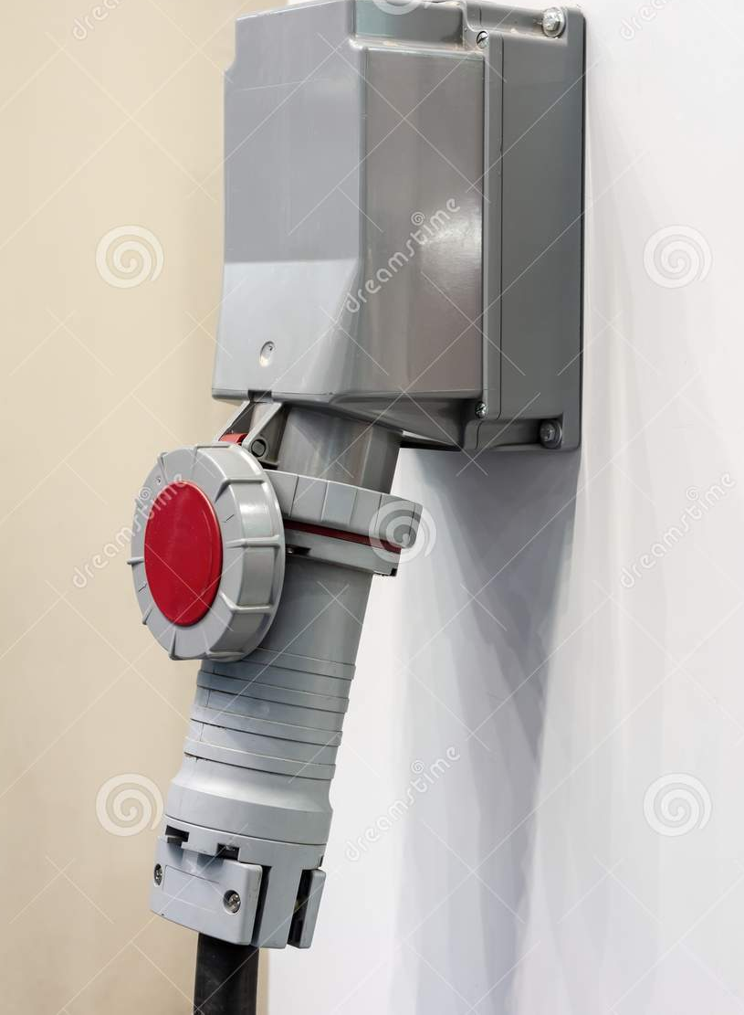
Connecting the government balance sheet to the budget
Notes:
Governments do not have a connection between this vast power source , the balance sheet, and and its budget where it spends all the money. It just takes in what it needs in taxes.

Slide 17
Developing
public assets
to their best and highest use
Notes:
Since governments do not recognise they own assets, they do not care for them or manage them as something that is valuable.
“what is not measured, does not count” is a phrase often used. That is as if you own ten houses but are not aware of their existance, then surely other people will notice that nobody cares about that house and use it for their purposes. The houses will fall into disrepair since nobody feels responsible and the people living there are just happy they have not been kicked out and will surely not invest in them or repair anything.
The alternative would be for governments to recognise their assets, with modern accounting, and by developing (normal repair and maintance, as well as buiding a house on an empty parking lot, or transforming a abandoned old factory to an apartment building etc).
Managing water utilities, airports, ports and subways as your most precious possessions, like the arteries and muscles of your body that needs regular exercise and healthy food (not drugs, nicotine, alcohol and fast food that feels good for the moment but leaves you a wreck) for the long term well being and a good life. The easy way out today, has a cost on tomorrow.

Slide 18
Public real estate
Notes:
https://www.imf.org/external/pubs/ft/fandd/2018/03/pdf/detter.pdf

Slide 19
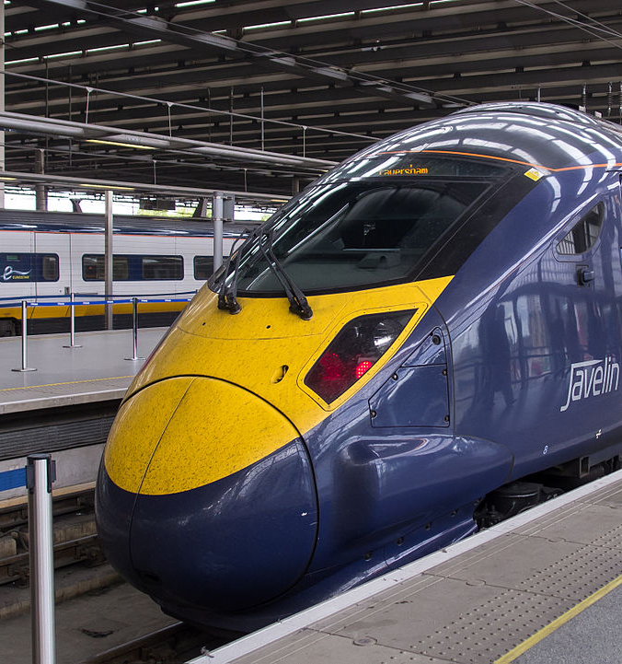
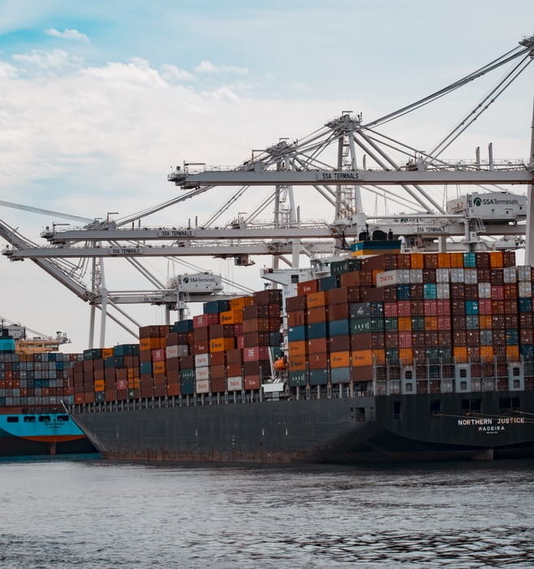
and operational assets
is a source of income, complementing
taxes
Notes:
https://www.brookings.edu/book/the-public-wealth-of-cities/

Slide 20
Professionally managed
inside …Public Wealth Funds

Slide 21
Enables…
Teamwork on equal terms with the private sector
Notes:
The private sector is not the enemy, ‘stealing’ public assets. Its rather the public sector not being fit for purpose to interact with the private sector with regards to its vast portfolio of public commercial assets.
The private sector has a never ending ambition to understand what they own and the status of that property (with modern accounting), as well as relentless ambition to constantly make its commercial assets perform better in every moment.
That is in stark contrast to the public sector, that does not even recognise it owns any commercial asset and fails to understand its value.
No wonder then when the public sector tries to interact with the private sector regarding its commercial assets, it loses – big time. Its like asking the boy scouts fight a war, or Messi putting on skates and try to play ice hocket with the New York Rangers.
The public sector needs to set up a professional organisation, that reflects the best of what the private sector has developed to manage commercial assets, and populate it with the relevant professionals. We need an ‘All Blacks’ team if we are to play rugby, not an office clerk with a passion to play paddle.

Slide 22
without excessive
taxes or privatisations
Notes:
“a chain is no stronger than its weakest link” or An organisation is only as strong or powerful as its weakest person. A group of associates is only as strong as its laziest member.
Due to the lack of proper accounting, governments have a tendency to either just raise taxes or sell of an asset in panic (’fire sale’) just to fill the deficit in an ambitous budget to spend as much as possible (to win votes and get re-elected)

Slide 23
This is not rocket science
Notes:
This is not any revolutionary or ground breaking technology. Accounting is more than 800 years old and the private sector does this asset management every day, even private individuals like yourself is more sophisticated.

Slide 24
But, rather like
‘Hidden figures’
Notes:
But like the brilliant mathematicians putting a man on the moon, they had the wrong background.
People running governments are mostly economists, or at least entirely influenced by economists. Accounting and asset management is not on the curriculum at any university teaching economics.
We need more accountants and more financial thinking in the public sector: https://www.ifac.org/knowledge-gateway/contributing-global-economy/discussion/economic-growth-world-needs-accountants

Slide 25
Finally, getting their due
Notes:
The Hidden Figures finally got recognised, it took coloured president and almost 60 years.
Governments have only waited 800 years and are still waiting for proper recognition.
Read ‘The Undercover Economist, Tim Harford’s brilliant article: Late greats: why some brilliant ideas get overlooked (https://on.ft.com/gift_link)

Slide 26
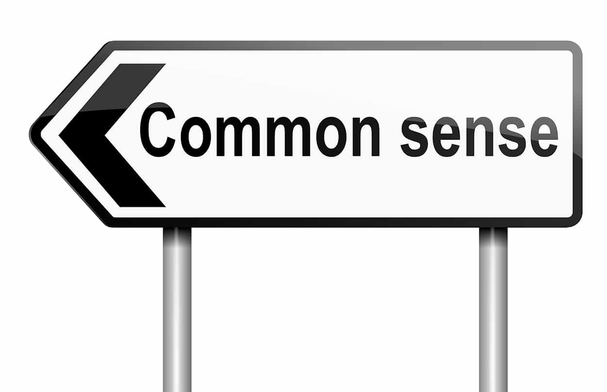
The
Public Wealth Fund
- is simply a tool…

Slide 27
A renewable funding resource

Slide 28
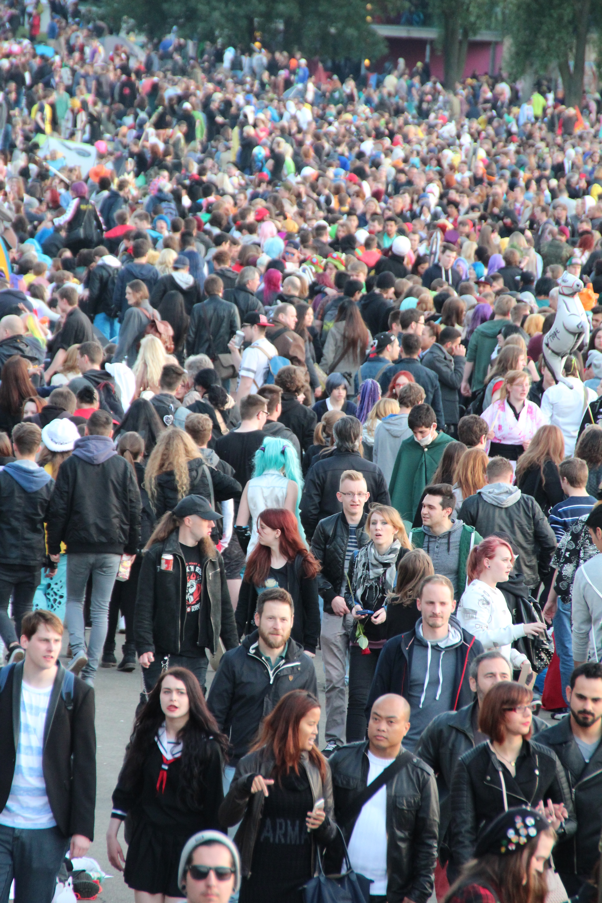
To the benefit of society as a whole

Slide 29
…and the planet
Det här fotot av Okänd författare licensieras enligt CC BY-SA

